Slide 1
Deferred Sales Trust™
Notes:
Welcome!
Introduce yourself, and introduce Estate Planning Team and the Deferred Sales Trust.
I am a member of a company called Estate Planning team. At the center of our company is a structure that may be helpful for you acquiring additional sales and closings called The Deferred Sales Trust™ our 21-year-old structure allows a seller to defer taxes, mitigate tax exposure and provide for estate planning solutions. Ultimately, by taking taxes off the table, selling and refinancing becomes brisk for the sellers.

Slide 2
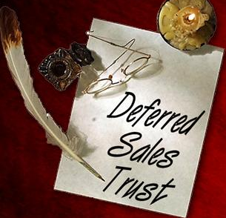
Option 1: Don’t Sell
Option 2: 1031 Exchange
Option 3: Deferred Sales Trust™
Option 4: Sell & Pay the Tax
Notes:
In today’s real estate market, your client has 4 options when it comes to selling an asset.
Don’t sell: Your client may be advised to keep the property and wait for an ill timed event such as death, step up in basis.
1031 exchange: the fees are minimal, Rigid Rules; clients have 45 days to identify exchange property and 180 days to close short deadline. If exchanges fail, all the taxes are due. Nationwide a large percentage of 1031 exchanges fail. Not diversified if invested in a single asset. Clients have to replace their existing debt in order to make the exchange work. Possible exchange into an overvalued market.
DST: Defer capital gains tax and cash out of real estate or a business at the opportune time. Ability to diversify your DST note and earn interest on a portion of what would normally be paid to the IRS and your state. The clients must sell to a third party trustee, give up some control and become secured lender.
Sell & Pay Tax: Depending on your income you could be facing higher capital gains tax, depreciation recapture and Net Investment Income Tax. No tax benefit or investment from deferral of capital gains. Freedom to do what you want with your money.

Slide 3
The Perfect Storm:
Demographics + Taxation + Low Interest Rates
According to the American Bankers Association, $17 Trillion of assets will pass from one generation to another over the next 20 years
The largest generation in the history of the planet known as the “The Baby Boomers” are starting to retire
There are 77 million Baby Boomers in the U.S alone
Every day about 10,000 Baby Boomers will turn 65
Demographics
Taxation
Capital gains rates have increased
Net investment income taxes have been created (known as the “Obama Care” tax)
Many state income taxes have increased
Some sellers may face double taxation, corporate taxes and personal taxes
Low Interest
Rates
Interest rates in the United States are hovering near 40 year lows
Real Estate has appreciated a great deal over the years
1031 timelines and restrictions make finding a quality deal challenging
Low inventory to choose from
Notes:
According to the American Bankers association 17 Trillion dollars of assets will pass from one generation to another over the next 20 years

Slide 4
How Do We Know It’s Legal?
IRC 453, Installment Sales
Deferred Sales Trust – 21 years
Reviewed by IRS
Reviewed by FINRA
Reviewed by National Tax Law Firms
Audit Defense
Notes:
IRC 453 – have been around for a long time, it’s a well settled law.
Deferred Sales Trust – 21 years, over 2000 trusts, 13 audits with no change and DST was not the reason for the audit.
Campbell Law provides audit defense in our engagement agreement for the life of the promissory note.

Slide 5
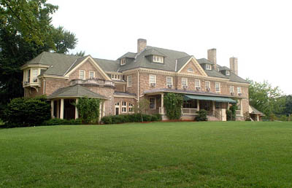
John Smith Sample Case
BUSINESS OR REAL ESTATE FOR SALE
$5,000,000 Sale
$1,000,000 Dollar Cost Basis
$4,000,000 Gain will be taxed
- Federal 20% Tax
- State - CA. 13.3% Tax
- Medicare Tax 3.8%
^{TAXES DUE $1,484,000!}
WHY PAY THE CAPITAL GAINS WHEN YOU CAN DEFER THEM!
Notes:
Sample case for John Smith IF HE DOES NOT USE THE DST…He pays $1,484,000 million in taxes.

Slide 6
Deferred Sales Trust™
How does a DSTTM work?
Clients
Assets to Sell
Third party DST
trustee buys the assets.
Sells to a third party trustee in consideration of a secured DST installment contract
Sells Assets to Cash Buyer
Cash Buyer
Secured DST installment payments made to seller from the trust
$$ Cash to Trust in exchange for the assets
Notes:
6
Clients own an asset that they want to sell. This asset has capital gains. Instead of selling the asset directly to a cash buyer they would sell it to a third party trustee in exchange for an irc 453 installment contract. The trustee will buy the asset for the full purchase price and sell it to the cash buyer for the same price that they bought it for. With no capital gains to the trust. The trust has cash that needs to be invested. The investments will generate income which will be paid to the seller under an installment contract.

Slide 7
3 Sets of Fees
Tax Attorney - One time fee
1.5% of trust up to $1 Million of net proceeds
1.25% on anything over $1 Million of net proceeds
Legal and tax structure
Audit defense
Trustee Management – Annual - 50 basis points
Annual tax return in $500 – $1,000 range
Out of network investments – 100bps annually
Financial Advisor Investment Fees
Ranges from .50bps – 100bps depending on account size
Notes:
You can expand here on your typical fees.

Slide 8
Can the DST Invest Back Into Real Estate or a Business? The answer is YES!

Slide 9
Deferred Sales Trust™
LLC
80%
Managing Member
20%
Preferred
Member
DST Noteholder
$1M
Deferred Sales Trust™ (DST)
The DST contributes $1M of capital to the LLC to make investment
Promissory Note
$1 Million after transfer to LLC)
To invest in new projects, the DST partners with the DST Noteholder in a newly formed LLC, the DST is the preferred member with a back-end waterfall of 20%. The DST contributes capital as needed (assumed $3 million) to the LLC to complete the investment.
Notes:
You can skip or delete this slide if this is too complex to explain. The previous slide is the key slide. You can let them know when they become members, we can walk them through how this concept works.

Slide 10
Deferred Sales Trust™
DST INSURANCE SALE
$5 Million DB
ILIT Formed
Deferred Sales Trust™ (DST)
The DST contributes $200K per year in premium
$200 K
DST Funds
$20 M
Pay $200K out of earnings for X years, pay taxes @50% bracket = $400K
Loan–preferred return trust access to pay 200k for X years. ILIT M 2T pay back 200K for X years. Death benefit to repay loan and interest rate tied to nominal rate.
Premium Finance with loan preferred return. As above but financing premium. *
* DB must be greater than $5 M

Slide 11
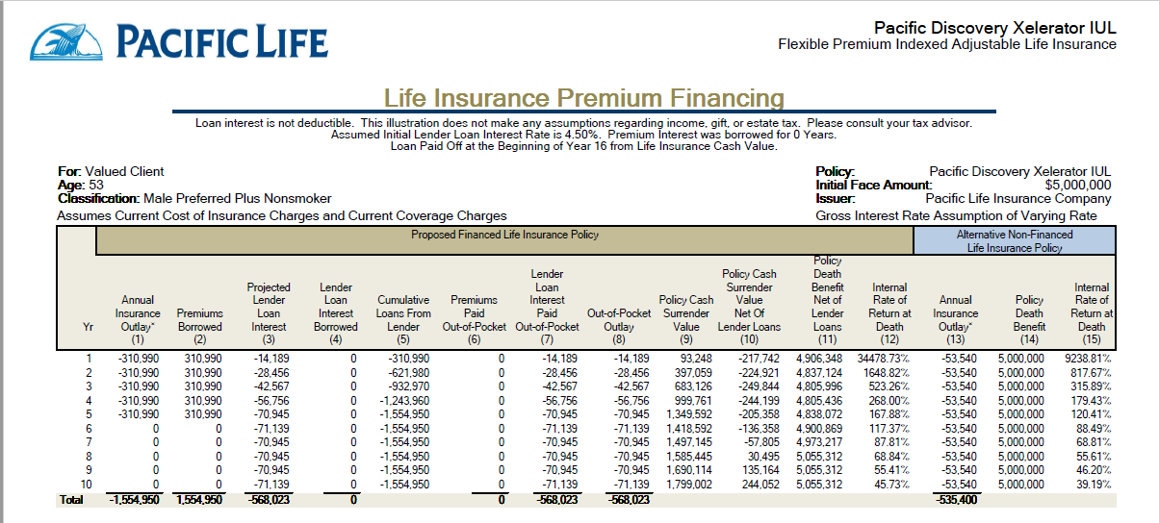
Valued Client
Age: 53
$5,000,000 DB

Slide 12
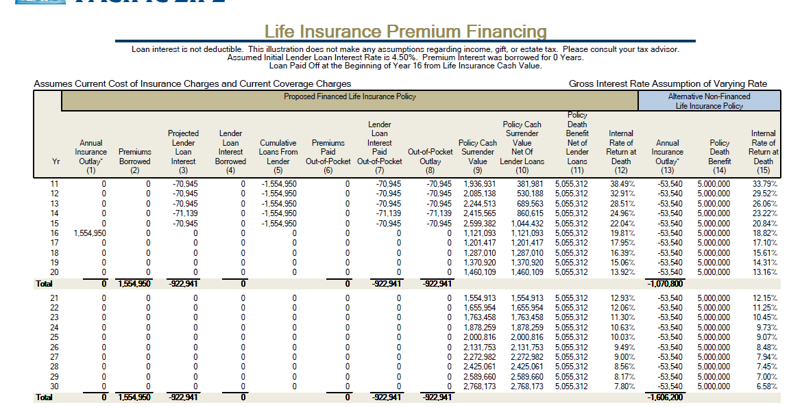

Slide 13
Thank you for joining us today!
Please contact Garrett at: 816.721.8093 or garrett@legacylegalkc.com
with any questions or comments

